Slide 1



Object-Oriented Programming (in Java)
week1
Ozacar Kasim, PhD | Assist. Prof. Computer Engineering Department

Slide 2
OOP course at a glance
Week1 : Introduction to Object-Oriented Programming
Week2 : Introduction to Classes: Declaring a class and initializing an object
Week3: Introduction to Classes: Class Constructors, UML
Week4 : OOP in Java: OOP Concepts: Encapsulation + (Exception handling).
Week5 : OOP in Java : Static methods, Nested Classes, Enum types, Deeper in classes
Week6 :Deeper in Classes: this() method & toString() + Examples
Week7 : Deeper in Classes: Working with multiple classes
Week8 :OOP Concepts: Inheritance
Week9 : OOP Concepts: Polymorphism
Week10: OOP Concepts: Abstraction => Interfaces, Multiple inheritance
Week11:Java Collections Framework: Lists
Week12: Java Collections Framework: Set & Map
Week13: GUI with Swing
Week14: GUI-2 with Swing
L1, L2
L3, L4
L5, L6
L7, L8
L9, L10
L11, L12
L13, L14

Slide 3
Table of Contents
Precaution
Installing IDE for Java
Computer Languages
Fundamental concepts:
Classes
Objects
Instance
OOP concepts

Slide 4
Precaution
Attendance:
5 times absence will prevent you to take final and makeup exam.
Evaluation:
Midterm %40, Final exam %50, Quiz/Project +%10

Slide 5
Course Educational Objectives:
This course enables the students to know about
Classes & Objects
Object Oriented concepts in Java language
Encapsulation,
Inheritance,
Polymorphism,
Abstraction

Slide 6
Course Outcomes:
After completion of the course, you will be able to:
CO1: Able to Understand OOPs Concept, Java language features. Able to Understanding and Applying various Datatypes in program design.
CO2: Able to Understand and Apply the concepts of Classes &Objects, constructors in program design.
CO3: Able to Design & implement various forms of inheritance ,calling base class constructors .
CO4: Able to Apply & Analyze method overloading, runtime polymorphism , Generic Programming.
CO5: Able to Analyze and explore I/O operations and exception handling.

Slide 7
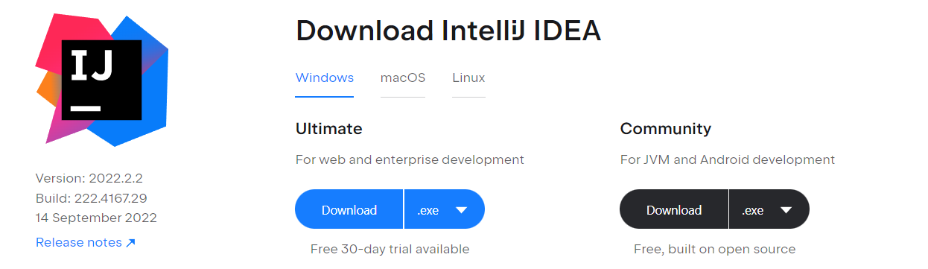

IDE we will use: IntelliJ IDEA Community Edition
Community Edition is free and open-source, licensed under Apache 2.0. It provides all the basic features for JVM and Android development.
It enables you to create graphical user interfaces (GUI) for your applications using Swing library components.

Slide 8
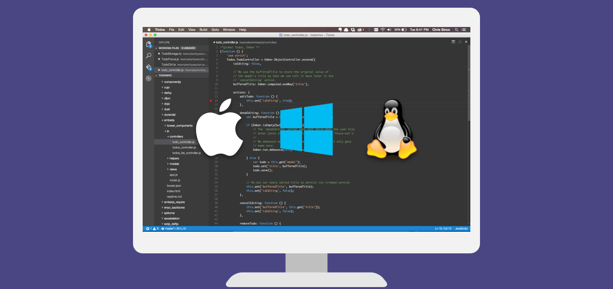
Another option: Visual Studio Code
Visual Studio Code combines the simplicity of a source code editor with powerful developer tooling, like IntelliSense code completion and debugging. VS Code supports GUI applications.
Free.
Built on open source.
Runs everywhere.
Available for macOS, Linux, and Windows

Slide 9
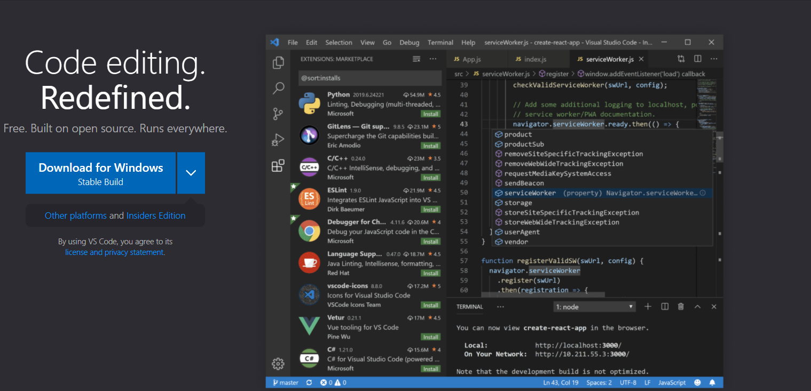
Installing VS Code
Download VS Code for Windows!
https://code.visualstudio.com/

Slide 10
Setting up Visual Studio Code for Java Development
https://code.visualstudio.com/docs/java/java-tutorial#_installer-of-visual-studio-code-for-java-developers
Install JavaCodingPack-0.3.8.exe
Done!

Slide 11
Others
Eclipse
NetBeans
BlueJ
(Oracle) JDeveloper
DrJava
jGRASP MyEclipse
…

Slide 12
Computer Languages

Slide 13
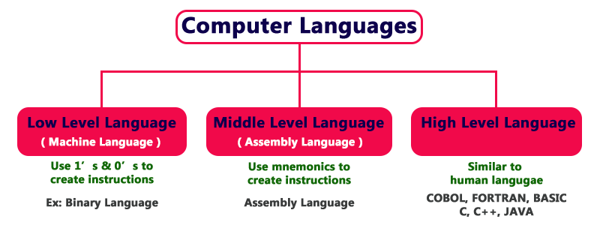
Language levels
The only language understood by a computer is machine language.

Slide 14
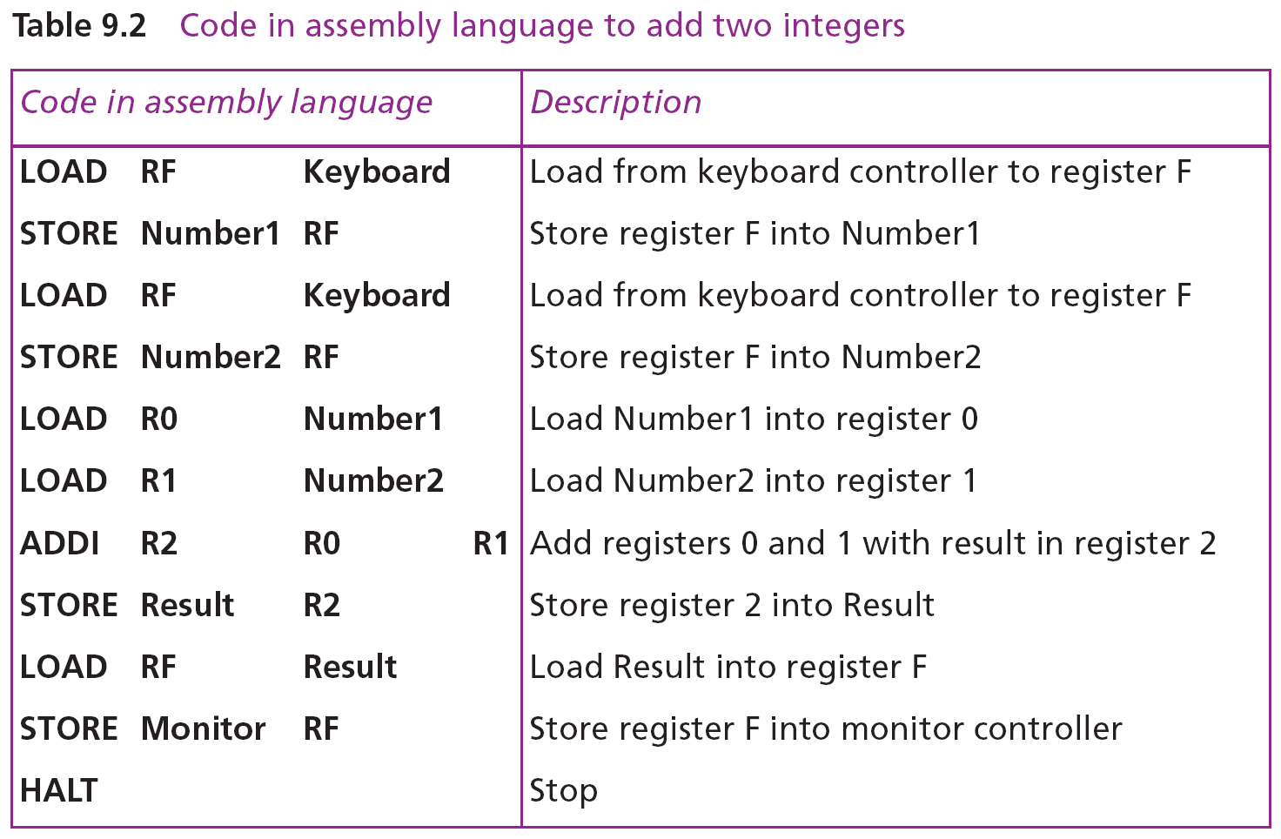
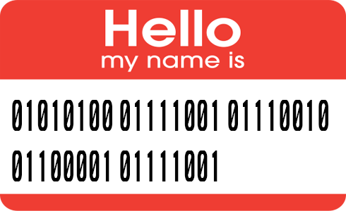
Understanding Languages
public static void main(String[] args) {
Player human = new Player("HUMAN",5);
Player pc = new Player("PC");
do{
human.Move();//a human object from Player class moves!
pc.AutoMove();//a pc object from Player class moves!
Player.ProcessMoves(human,pc); //static method.
}
while(!Player.isGameOver);
Player.ShowScores(human, pc);
}
Notes:
???:

Slide 15
Understanding Languages
A High-level language: Java
public static void main(String[] args)
{
Player human = new Player("HUMAN",5);
Player pc = new Player("PC");
do
{
human.Move();//a human object from Player class moves!
pc.AutoMove();//a pc object from Player class moves!
Player.ProcessMoves(human,pc); //static method.
}
while(!Player.isGameOver);
Player.ShowScores(human, pc);
}

Slide 16
Difference Between Low, Middle, and High-Level Programming Languages
Speed: Programs written in low-level languages are faster than the others. Because these programs do not need to be interpreted or compiled.
Memory requirement: Low-level languages are very efficient in terms of memory. They consume less memory.
Ease of use: Low-level languages are unfriendly to human programmers. High-level languages are human-friendly.
Portability: High-level languages are machine-independent.
Abstraction: High-level languages have the maximum level of abstraction. (it handles complexity by hiding unnecessary details from the user. )
https://www.technotification.com/2018/10/low-middle-high-level-programming.html

Slide 17
Java Introduction
Java is one of the world’s most widely used programming languages.
You’ll learn to write instructions commanding computers to perform tasks.
Software (i.e., the instructions you write) controls hardware (i.e., computers).
You’ll learn object-oriented programming
today’s key programming methodology.
You’ll create and work with many software objects.
Notes:
Java, dünyanın en yaygın kullanılan programlama dillerinden biridir.

Slide 18
A Simple Application
import java.util.ArrayList // like #include
package chapter1; //like namespace
public class Welcome { //class
//method (or say Function)
public static void main(String[] args) {
System.out.println("Welcome to Java!");
}
}

Slide 19
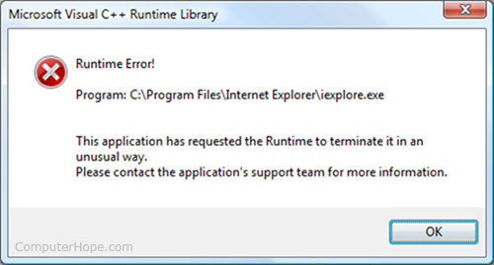
Creating and Compiling Programs
On command line
javac file.java
The JVM takes the byte code and generates machine code.

Slide 20
Executing Applications

Slide 21
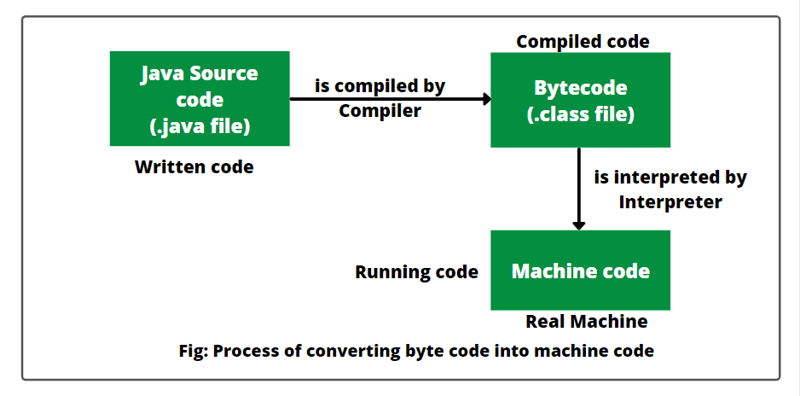
How does Java work on a computer?
Java can be considered both a compiled and an interpreted language because its source code is first compiled into a binary byte-code. This byte-code runs on the Java Virtual Machine (JVM), which is an interpreter.

Slide 22
Java Editions
Java Standard Edition
Java Standard Edition (SE) contains the capabilities needed to develop desktop and server applications.
Java Enterprise Edition (Java EE) is geared toward developing large-scale, distributed networking applications and web-based applications.
Java Micro Edition (Java ME)
a subset of Java SE.
geared toward developing applications for resource-constrained embedded devices, such as
Smartwatches
MP3 players
television set-top boxes
smart meters (for monitoring electric energy usage)
and more.

Slide 23
Need for OOP

Slide 24
Procedure-oriented Programming(POP) vs Object-oriented programming(OOP)
POP
OOP
Main focus is on "how to get the task done" i.e. on the procedure or structure of a program
Large program is divided into functions(methods)
C, Basic, Fortran, Pascal
Main focus is on 'data security'. Hence, only objects are permitted to access the entities of a class.(*)
Entire program is divided into objects.(**)
C++, JAVA, C#, Objective-C, Phyton, Dart, Swift…
Notes:
*Ana odak noktası 'veri güvenliği' üzerinedir. Bu nedenle, yalnızca nesnelerin bir sınıfın varlıklarına erişmesine izin verilir.
**Tüm program nesnelere bölünmüştür.

Slide 25


Procedure-oriented Programming(POP) vs Object-oriented programming(OOP)
Procedure-oriented Programming(POP)
Object-oriented programming(OOP)

Slide 26
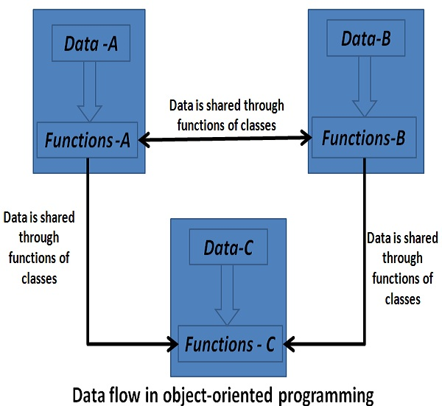
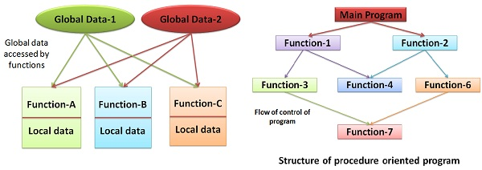
Procedure-oriented Programming(POP) vs Object-oriented programming(OOP)
function = method
POP
OOP

Slide 27


History of OOP
Alan Kay invented the term “object-oriented programming” at grad school in 1966 or 1967.
The idea was to use encapsulated mini-computers in software which communicated via message passing rather than direct data sharing.
Purpose was to stop breaking down programs into separate “data structures” and “procedures”.

Slide 28
Introduction to Object Technology

Slide 29
Object
An object is a single instance of a class, which contains data and methods working on that data.
Objects (comes from classes) are reusable.
Date, time, audio, video, automobile, people objects, etc.
Almost any noun can be represented as an object in terms of
attributes (e.g., name, color and size) and
behaviors (e.g., calculating, moving and communicating).
Object-oriented design approach is much more productive than with earlier popular techniques like “Procedural programming”
Object-oriented programs are often easier to understand, correct and modify.
Notes:
Objects, or more precisely, the classes objects come from, are essentially reusable software components.

Slide 30
The Automobile as an Object
The Automobile as an Object
Let's say, you want to drive a car and make it go faster by pressing its accelerator pedal.
Before you can drive a car, someone must design it.
A car typically begins as engineering drawings (blueprint or template), where you define attributes and behaviors (Class)

Slide 31
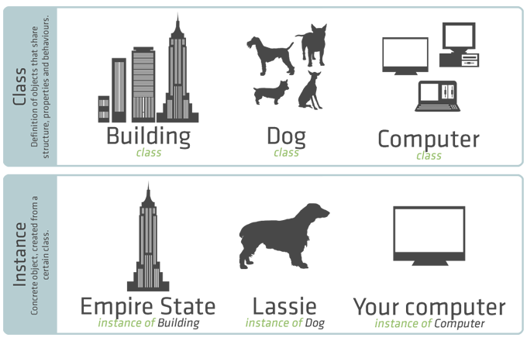
Objects and Classes
Class − A class is a blueprint or template or set of instructions to build a specific type of object
Object- An object is a component that contains attributes and behaviors needed to make a certain type of data useful.
Instance- An instance is a specific object built from a specific class

Slide 32
Class members
Objects have
attributes (e.g., name, color and size) and (variables)
behaviors (e.g., calculating, moving and communicating). (functions/methods)
A car has attributes
Color, its number of doors, the amount of gas in its tank, its current speed and its record of total miles driven (i.e., its odometer reading).
The car’s attributes are represented as part of its design in its engineering diagrams.
Every car maintains its own attributes.
Methods are used to perform some tasks of the objects. (like functions)

Slide 33
Instantiation
Just as someone has to build a car from its engineering drawings before you can actually drive a car, you must build an object of a class before a program can perform the tasks that the class’s methods define.
An object is then referred to as an instance of its class.

Slide 34
Example
A class is a blueprint from which individual objects are created.
public class Dog {
String breed; int age; String color;
void bark() {}
void hunger() {}
void sleep() {}
}
variables
attributes
public class JavaApplication1 {
public static void main(String[] args)
{
Dog dog = new Dog();
dog.bark();
}
}
methods
behaviors
Object: An instance of Dog class
Method call
Notes:
method call that tells a method of the object to perform its task.

Slide 35

Another Example: Car class
Attributes
Model
Color
Year
Price
Behaviours
StartEngine()
Drive()
Stop()
This Car class can be reused many times to build many cars, you can reuse a class many times to build many objects.
Reuse of existing classes when building new classes and programs saves time and effort.

Slide 36
Why OOP?
Object 2
Object 1
Data
Data
Data
Method
Method
Method
Object 3
Save development time (and cost) by reusing code
once an object class is created it can be used in other applications
Easier debugging
classes can be tested independently
reused objects have already been tested
Software maintenance
Easy to maintain then non-OOP programs

Slide 37
Next Week: Creating a class and instantiation
Declaration − A variable declaration with an object type.
Instantiation − The 'new' keyword is used to create the object.
Initialization − The 'new' keyword is followed by a call to a constructor.

Slide 38
This is the end of lecture. Any questions?
Anybody who comes to you and says he has a perfect language is either naïve or a salesman.
Bjarne Stroustrup
in C++ 0x - An Overview at University of Waterloo Computer Science Club

